Slide 1

DIGITAL SYSTEM DESIGN AND VERILOG
OPEN ENDED
B - DIV
TEAM - 9
Team Information:
NAME | USN | ROLL NO
E SAI LAKSHMI | 01FE24BEC076 | 233
MANOJ H A | 01FE24BEC077 | 234
ADITYA P V | 01FE24BEC078 | 235
YOGESH | 01FE24BEC079 | 236

Slide 2
INTRODUCTION
Dual-port RAM (DPRAM) is a special type of memory that allows two devices or processors to access the same memory simultaneously through two independent ports.
Key Features :
Ports operate without interfering when accessing different addresses.
It boosts performance in multi-processor systems by enabling parallel memory access.
No waiting occurs when ports access different memory addresses in dual-port RAM.

Slide 3
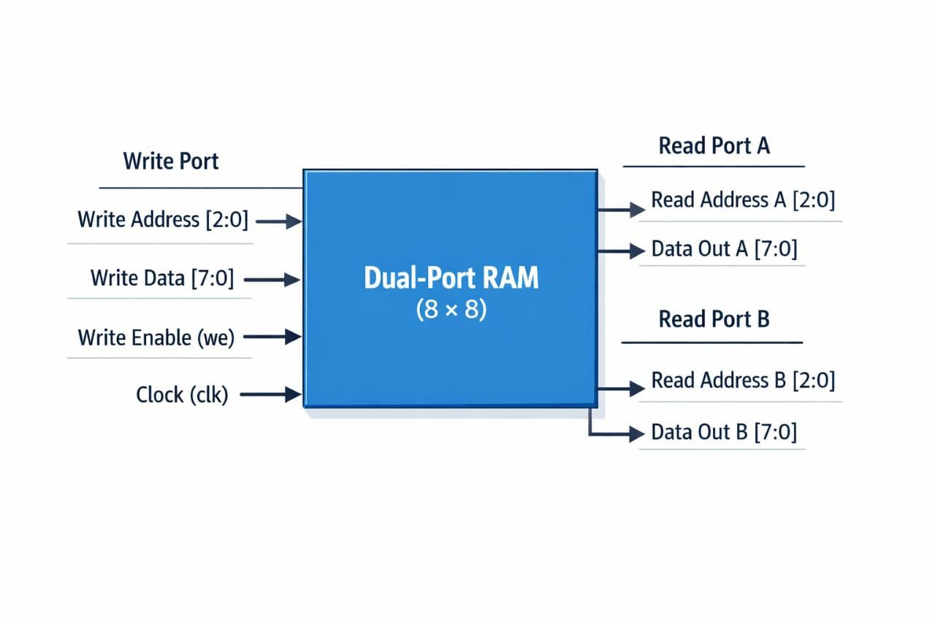
BLOCK DIAGRAM

Slide 4
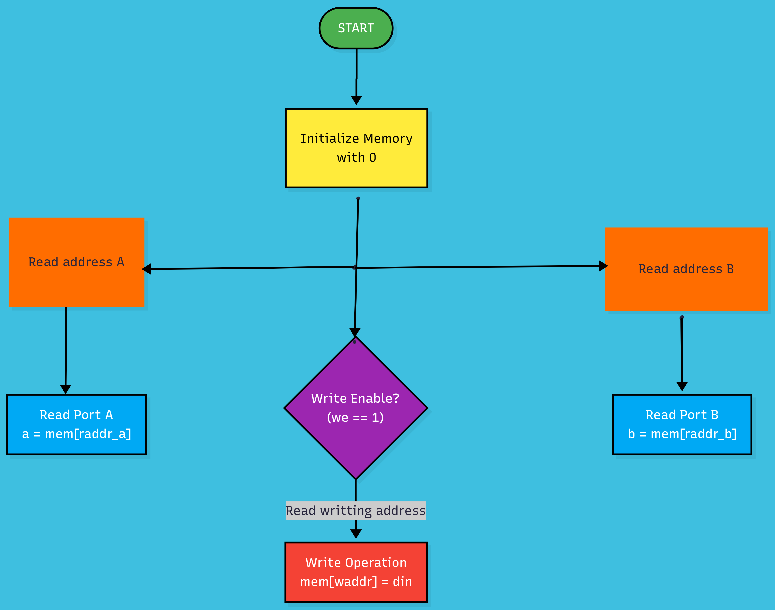
FLOW CHART

Slide 5
VERLOG CODE
`timescale 1ns / 1ps
module dual (
input clk,
input we,
input din,
input [1:0] waddr,
input [1:0] raddr_a,
input [1:0] raddr_b,
output reg a,
output reg b );

Slide 6
reg mem [3:0];
integer i ;
initial begin
for (i = 0; i < 4; i = i + 1)
mem[i] = 8'b0;
end
always @(posedge clk)
begin
if (we)
mem[waddr] <= din;
a <= mem[raddr_a];
b <= mem[raddr_b];
end
endmodule

Slide 7
TEST BENCH
`timescale 1ns / 1ps
module dualtb;
reg clk;
reg we;
reg din;
reg [1:0] waddr;
reg [1:0] raddr_a;
reg [1:0] raddr _b;
wire a;
wire b;

Slide 8
dual uut (clk, we, din, waddr, raddr_a, raddr_b, a, b);
always #5 clk = ~clk ;
initial begin
clk = 0; we = 0; din = 0; waddr = 0; raddr_a = 0; raddr_b = 0; #10; we = 1; waddr =2'b00; din = 1'b0; #10; waddr = 2'b01; din = 1'b1; #10; waddr = 2'b10; din = 1'b0; #10; waddr = 2'b11; din = 1'b1; #10; we= 0; raddr_a = 2'b00; raddr_b = 2'b01; #10; Raddr_a = 2'b10; Raddr_b = 2'b01; #10; #20; End endmodule

Slide 9
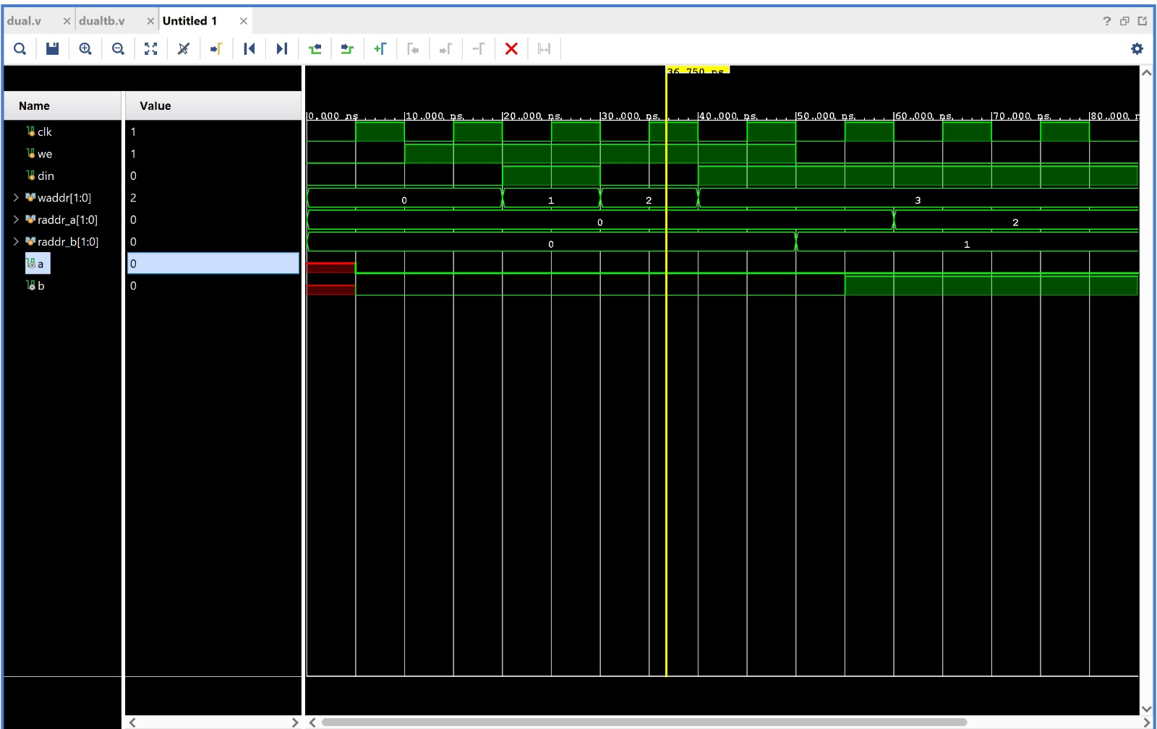
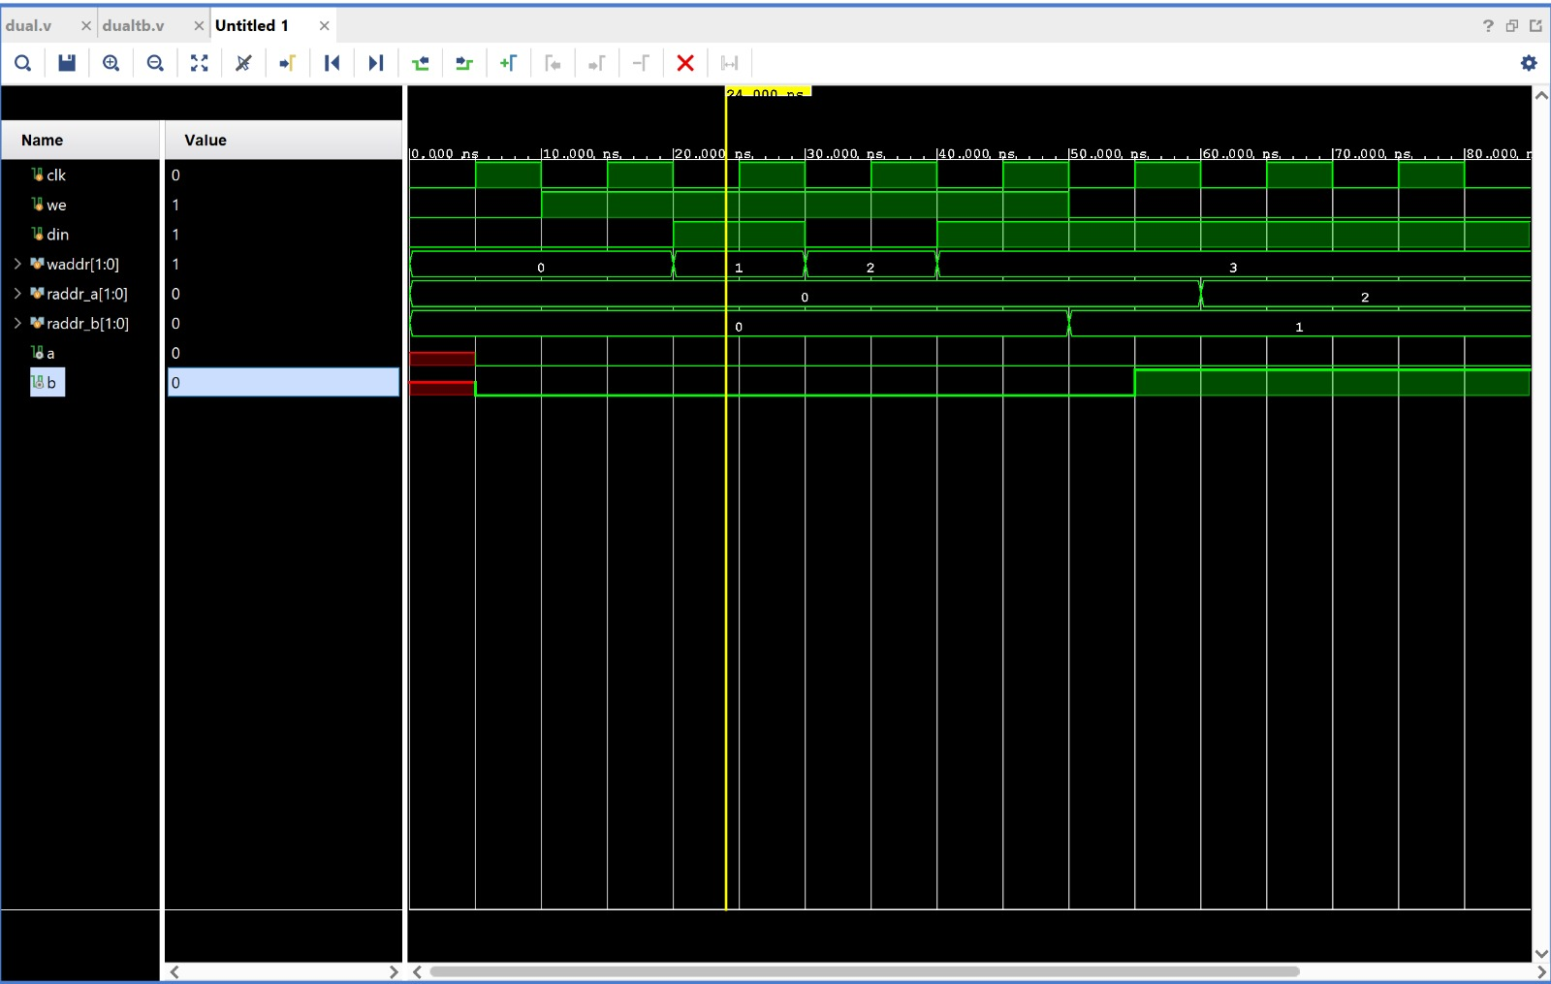
SIMULATION RESULT

Slide 10
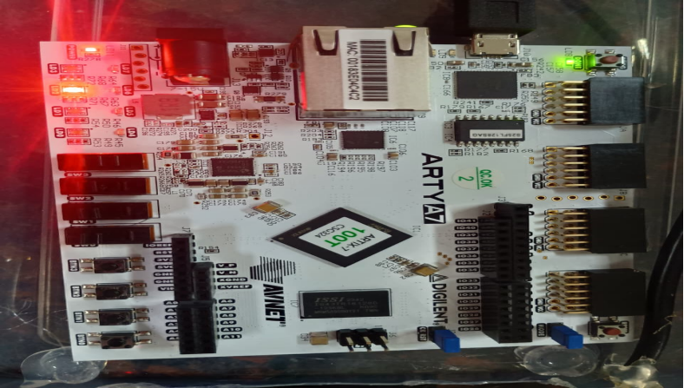
IMPLEMENTATION

Slide 11
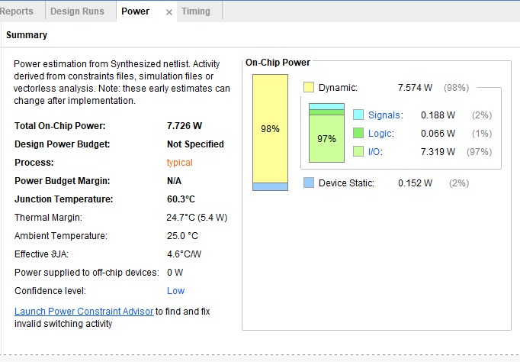
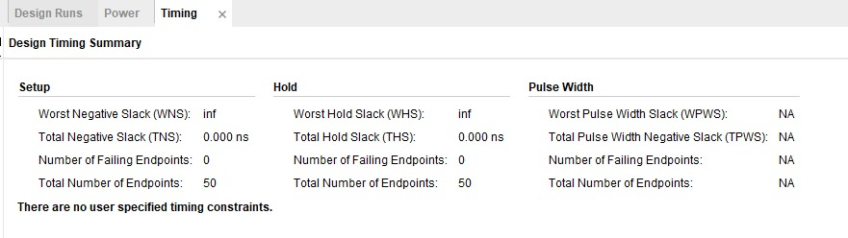
SYNTHESIS REPORT

Slide 12
THANK YOU

